Slide 1
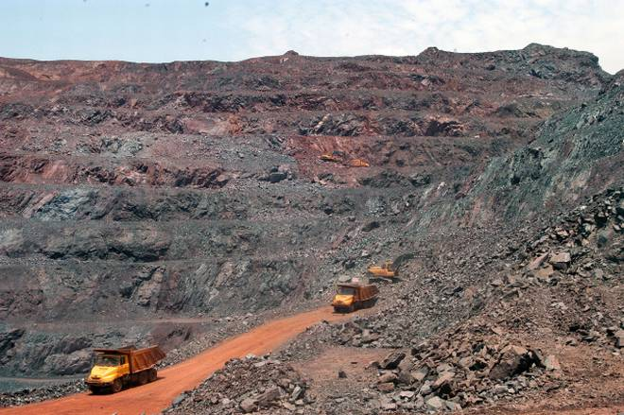
How Ballari was laid waste
Case Study - 2
Source: The Hindu
Notes:
Additional reading material and sources for this presentation:
Page 92 of the environmental reader textbook
https://www.downtoearth.org.in/coverage/how-bellary-was-laid-waste-33862
https://www.downtoearth.org.in/coverage/what-bleeds-bellary-1739
https://www.outlookindia.com/magazine/story/the-wanton-sins-of-the-soil/277937
https://economictimes.indiatimes.com/news/politics-and-nation/anatomy-of-bellary-mining-loot-efficient-system-of-corruption-to-mine-store-and-transport-iron-ore/articleshow/9424299.cms
Prepared by: Shaurya Rahul Narlanka

Slide 2
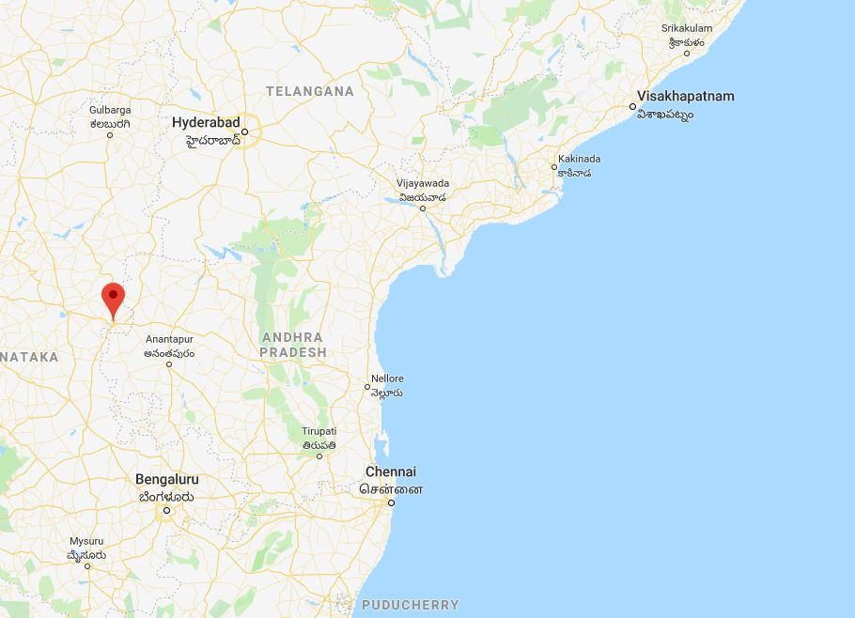
Ballari
Ballari: Introduction
Source: Google Maps
Notes:
Ballari is a major city in the state of Karnataka, near the border between Karnataka and Telangana and nearly equidistant from Bangalore and Hyderabad. It is extremely rich in good quality iron ore with the iron content in its ore ranging from 60-65% (a very high concentration). As a result, it is a popular iron ore mining destination in India and the ore extracted from this region constitutes about 1/5th of India’s total output. A spurt in the local and Chinese demand for stainless steel has made mining in this region even more lucrative with prices soaring from round Rs.1,200 per ton in 2002 to around Rs.6000 per ton in 2006-2007. Unfortunately, this has also resulted in the emergence of illegal mining in the area which has ballooned into one of the biggest mining scams in India. Through the collusion of government officials, regulatory authorities and private companies, mining was done in the region by violating many environmental, mining, labor and land regulations.

Slide 3
Ballari is a major city in the state of Karnataka, near the border between Karnataka and Telangana and nearly equidistant from Bangalore and Hyderabad.
It is extremely rich in good quality iron ore with the iron content in its ore ranging from 60-65% (a very high concentration). As a result, it is a popular iron ore mining destination in India and the ore extracted from this region constitutes about 1/5th of India’s total output.
A spurt in the local and Chinese demand for stainless steel has made mining in this region even more lucrative with prices soaring from round Rs.1,200 per ton in 2002 to around Rs.6000 per ton in 2006-2007. Unfortunately, this has also resulted in the emergence of illegal mining in the area which has ballooned into one of the biggest mining scams in India. Through the collusion of government officials, regulatory authorities and private companies, mining was done in the region by violating many environmental, mining, labor and land regulations.

Slide 4
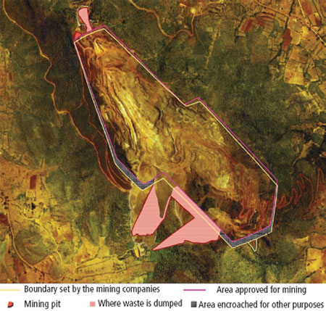
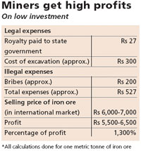
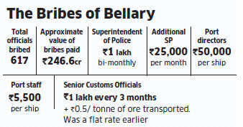
The Scam
Source: Down to Earth
Source: Down to Earth
Source: Economic times
Notes:
This map shows the extent of illegal mining in Ballari. The red line is the area approved for mining by the government. The yellow line is the boundary set up by the mining companies. The mining companies were supposed to mine and dispose the waste within the designated area. Furthermore, they were supposed to grow a green cover around the mine to suppress the dust released from the mining. Finally, they were allowed to only mine a certain amount of iron ore each day and pay royalties to the government for the ore they ship. None of these protocols were followed properly. The mining companies brazenly mined outside the designated zone, dumped mining refuse on the surrounding forest areas, did not install any green cover and paid the government very low royalties, costing the government an estimated 16000 Cr. Loss in royalties (as shown in table). The excess revenues were stored in off-shore accounts in Singapore to hide it from the Reserve Bank of India and other banks. Furthermore, existing mines were given extension leases and defunct mines were reopened without any check on their wanton environmental destruction. This was done through a comprehensive network formed by corrupt officials and private companies at every stage of the process. The table in the slide shows the estimated amount of bribe received by some of the officials in the government. In the Lokayukta report which revealed the extent of this scam, it was noted that Ballari is like a republic unto itself with no regard to national law and policies.

Slide 5
This map shows the extent of illegal mining in Ballari. The pink line is the area approved for mining by the government. The yellow line is the boundary set up by the mining companies.
The mining companies were supposed to mine and dispose the waste within the designated area. Furthermore, they were supposed to grow a green cover around the mine to suppress the dust released from the mining.
Finally, they were allowed to only mine a certain amount of iron ore each day and pay royalties to the government for the ore they ship. None of these protocols were followed properly. The mining companies brazenly mined outside the designated zone, dumped mining refuse on the surrounding forest areas, did not install any green cover and paid the government very low royalties, costing the government an estimated 16000 Cr. loss.

Slide 6
The excess revenues were stored in off-shore accounts in Singapore to hide it from the Reserve Bank of India and other banks. Furthermore, existing mines were given extension leases and defunct mines were reopened without any check on their wanton environmental destruction.
This was done through a comprehensive network formed by corrupt officials and private companies at every stage of the process. The table in the slide shows the estimated amount of bribe received by some of the officials in the government. In the Lokayukta report which revealed the extent of this scam, it was noted that Ballari is like a republic unto itself with no regard to national law and policies.

Slide 7
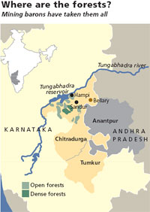
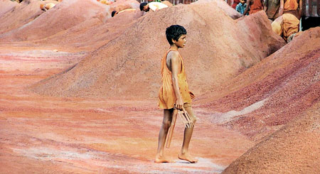
The Environmental Destruction
Source: Down to Earth
Source: Down to Earth
Notes:
The real tragedy of the Ballari wanton mining is the extent of damage to the people and environment of Ballari. The unsuppressed red dust released from mines are now the major source of respiratory illness in the region, especially for the children who were illegally employed in the mines and the women. When it rains in the region, the water collect the mud from the mines and deposit it in the Tungabhadra river and clog the Tungabhadra reservoir. As a result, the total capacity of the reservoir has fallen from about 133 thousand million cubic meters (TMC) to 99 TMC in recent years. Furthermore, because the refuse from the mines were not stored properly, they also enter the forest regions during the monsoons and destroy them causing many species like the Egyptian Vulture and Four-horned antelopes population to completely vanish.
Besides this, the mining has also impacted the earlier main source of employment in the region, agriculture. The top soil in most farms are now covered with iron rich soil making it nearly impossible to farm on them. This has made people very dependent on the mines for their employment. Now that the mines are closed, the total economy and, as a result, the resiliency of the locals has been destroyed and has led to extreme poverty in the region.

Slide 8
Consequences
The real tragedy of the Ballari wanton mining is the extent of damage to the people and environment of Ballari. The unsuppressed red dust released from mines are now the major source of respiratory illness in the region, especially for the children who were illegally employed in the mines and the women.
When it rains in the region, the water collect the mud from the mines and deposit it in the Tungabhadra river and clog the Tungabhadra reservoir. As a result, the total capacity of the reservoir has fallen from about 133 thousand million cubic meters (TMC) to 99 TMC in recent years.
Furthermore, because the refuse from the mines were not stored properly, they also enter the forest regions during the monsoons and destroy them causing many species like the Egyptian Vulture and Four-horned antelopes population to completely vanish.

Slide 9

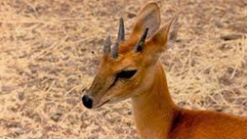
Egyptian vulture
Four horned antelope

Slide 10
Besides this, the mining has also impacted the earlier main source of employment in the region, Agriculture.
The top soil in most farms are now covered with iron rich soil making it nearly impossible to farm on them. This has made people very dependent on the mines for their employment.
Now that the mines are closed, the total economy and, as a result, the resiliency of the locals has been destroyed and has led to extreme poverty in the region.

Slide 11
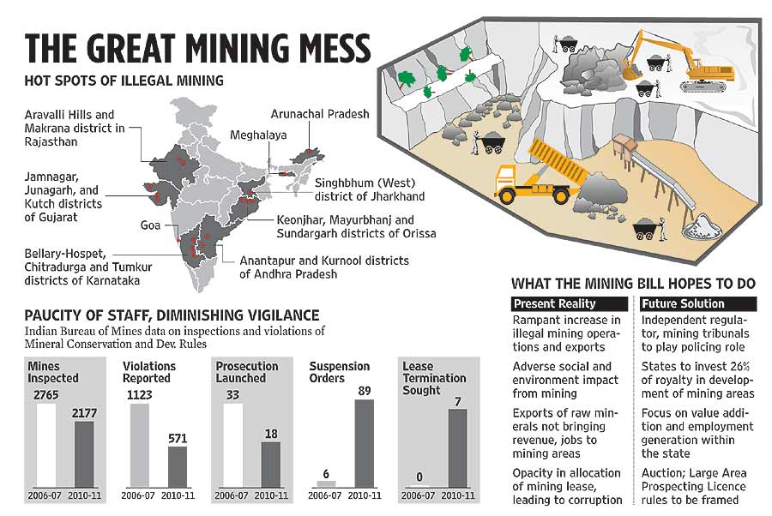
Source: outlookindia.com
Notes:
After the revelations of Ballari, many other such instances have come into the limelight around the country. The way the country deals with the Ballari scam with a new mining bill will set the precedent for the resolution of other illegal mining cases in India.

Slide 12
After the revelations of Ballari, many other such instances have come into the limelight around the country. The way the country deals with the Ballari scam with a new mining bill will set the precedent for the resolution of other illegal mining cases in India.

Slide 13
References :
Page 92 of the environmental reader textbook
https://www.downtoearth.org.in/coverage/how-bellary-was-laid-waste-33862
https://www.downtoearth.org.in/coverage/what-bleeds-bellary-1739
https://www.outlookindia.com/magazine/story/the-wanton-sins-of-the-soil/277937
https://economictimes.indiatimes.com/news/politics-and-nation/anatomy-of-bellary-mining-loot-efficient-system-of-corruption-to-mine-store-and-transport-iron-ore/articleshow/9424299.cms

